Slide 1

Wholetime Recruitment 2026 / 2027
Overview of the Service

Slide 2
Our People​:
287 Wholetime FF​
169 Retained FF​
25 Fire Control staff​
102 Corporate staff
Our Assets​:
26 Fire Appliances​
5 Targeted Response Vehicles​
10 Specials including National Resilience Assets
We're nothing without 'Our People'... - YouTube
Our Estate​:
15 fire stations
Headquarters​
Technical Services Centre​
Training Centre​

Slide 3
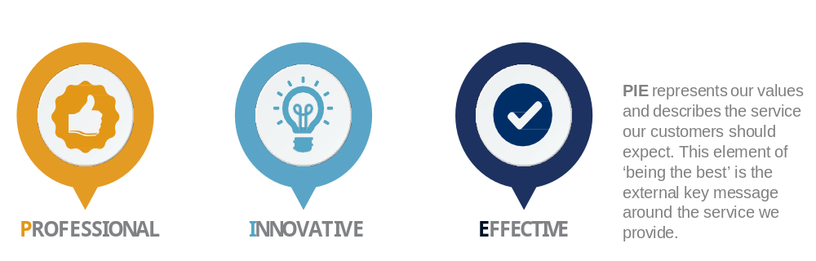
Values

Slide 4

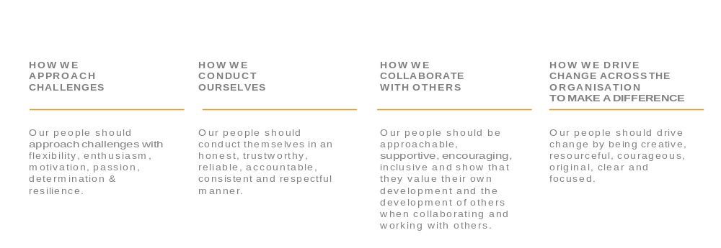
Behaviours

Slide 5
Diversity & Inclusion: Positive Action
Historically, the Firefighter role has often been stereotyped as a ‘White male role’.​
To challenge this perception, CDDFRS are working to increase diversity within the workforce by:​
Using inclusive language and actions​
Delivering Positive Action and Recruitment initiatives​
Applying fair and inclusive HR and Diversity & Inclusion policies​
This work is deliberately based on an interpretation of positive action that supports equality of opportunity.​

Slide 6
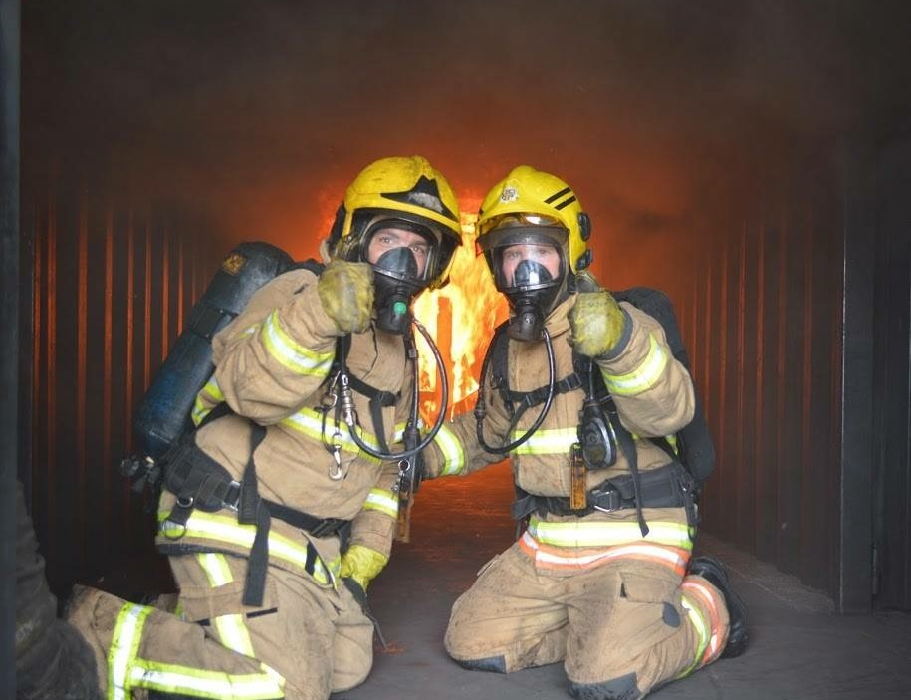
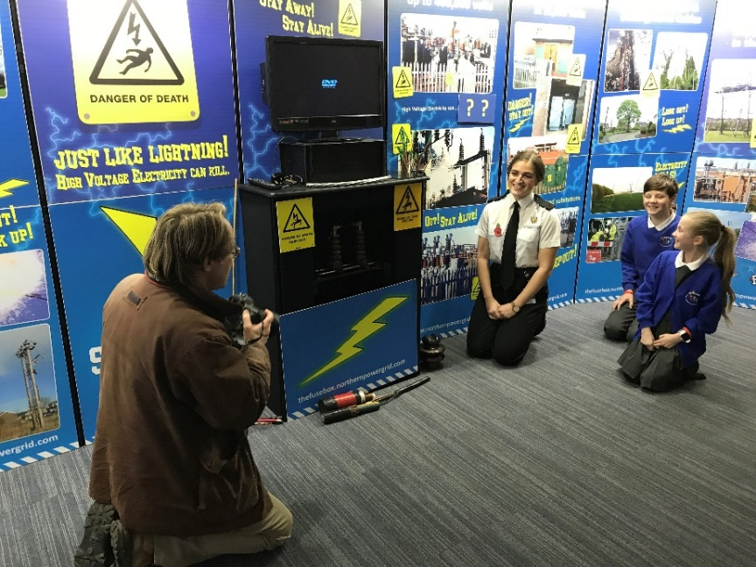
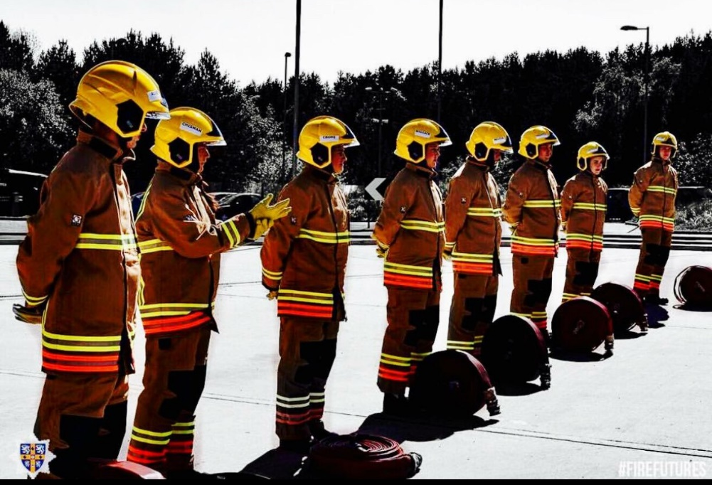
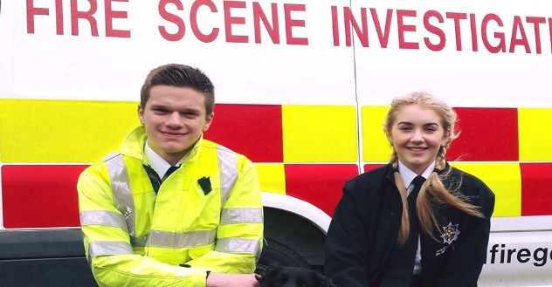
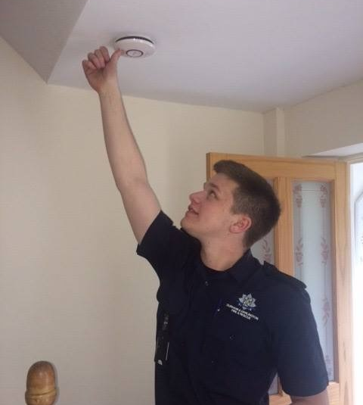
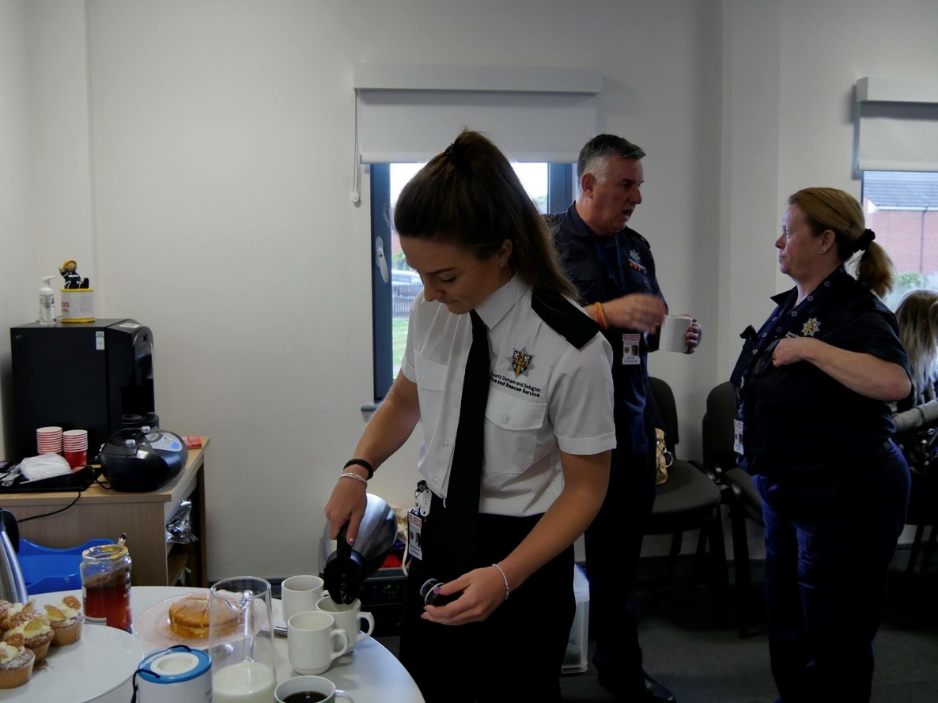
Role of a Firefighter

Slide 7
4. Health & Safety
5. Personal Fitness & Hygiene
6. Maintenance of Equipment
Emergencies
2. Dealing with People
3. Fire Safety
7. Local Geography
8. Administration
9. Training

Slide 8
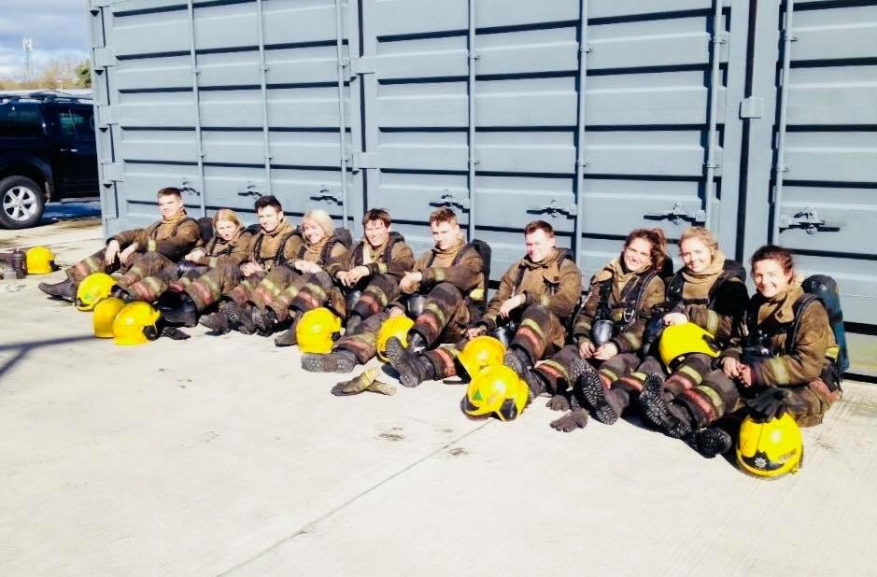
Wholetime
Commence Spring 2027 (Date to be confirmed).
Operational Firefighter Apprenticeship Level 3
24-month long apprenticeship.
Risk Critical Training at beginning of course.
Following completion of Risk Critical Training placed on station.

Slide 9
Entry requirements
To apply to be a Firefighter you need:​
Be 18 years old by start of employment in Spring 2027.
Be eligible to live and work in the UK​
You will be required to do a medical and a DBS check as part of the recruitment process​
Applicants need not hold a driving licence.​ They must, however, be able to work at locations across the geographical area.
No formal academic qualifications are required.

Slide 10
Firefighter Selection Process
Stage 1
Register Online
Stage 2
Online Mathematical, Verbal and Mechanical Test
Stage 3
Role Related Testing
Stage 4
Interview and Presentation
Stage 5
Recruitment Closes 18 October 2026
19 October – 1 November 2026
16 – 23 November 2026
7 – 18 December 2026
Fitness, Medical and Pre-employment Checks
January & February 2027 onwards
Stage 6
Course Begins
Spring 2027

Slide 11
Pay Rates
Phase 1 – Operational Firefighter Apprenticeship (24 months)
Development Rate of Pay - £31,539.00
Phase 2 – Firefighter (following successful completion of End Point Assessment)
Competent Rate of Pay - £40,358.00

Slide 12
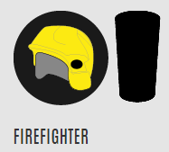
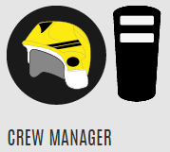
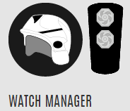
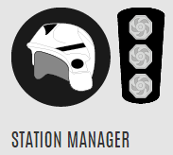
Pay, Progression and Promotion
Fully competent: £40,358
£44,742
£50,034
£57,402 plus 20% oncall

Slide 13
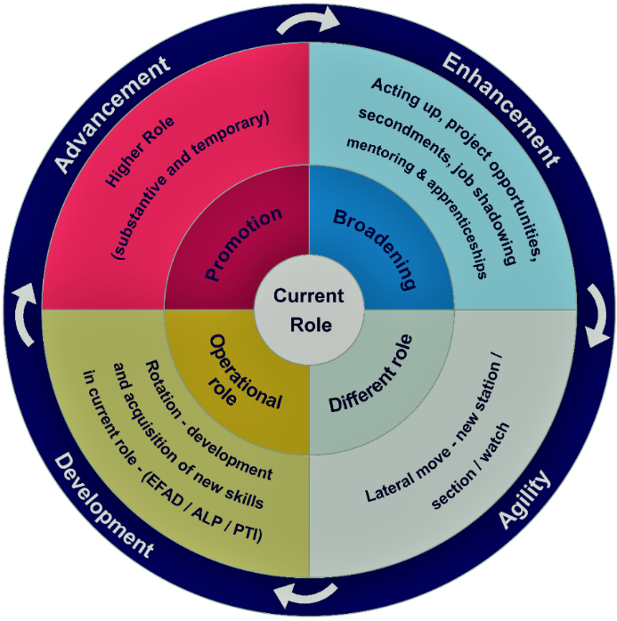
Career
Development

Slide 14
Benefits of working at CDDFRS
In addition to learning new skills & serving your community, you will have access to:​
  A rewarding career with promotion & career opportunities​
  Access to Sports & Social Clubs​
  Use of free CDDFRS fitness facilities and gyms​
  Training and development opportunities​
  Blue Light discount schemes​
  Pension scheme​
  Free parking onsite​
  Generous annual leave​
  Health & Wellbeing support (FFs Charity, Employee Assistants Programme - 24/7 counselling and occupational health, Fitness Advisor)​

Slide 15
Further Information
Information booklet
Our website https://www.ddfire.gov.uk
Email: humanresources@ddfire.gov.uk
Further Online Session –
    Role Related / Fitness – Wednesday 30 September 2026 at 7.00pm
    Interview – Wednesday 7 October 2026 at 7.00pm
    Online Tests – Wednesday 14 October 2026, 7.00pm
Positive Action Sessions
    Tuesday 13 October 2026, Darlington Fire Station, 6.00pm – 8.00pm
    Thursday 15 October 2026, Durham Fire Station, 6.00pm – 8.00pm
Good luck with your application & thank you for your interest

Slide 16

Any Questions

