Slide 1
Road Safety

Slide 2
Aims & Objectives
To explain what a Road Traffic Collision (RTC) is.
To highlight who is at risk and to inform you of the main contributing factors that can lead to RTC’s.
Understand the actions on what to do if you come across an Emergency Service vehicle(s) on a blue light response.
Have an awareness of the consequences behind your actions.

Slide 3
What is an RTC?
Notes:
A traffic collision, also called a motor vehicle collision among other terms, occurs when a vehicle collides with another vehicle, pedestrian, cyclist, animal, road debris, or other stationary obstruction, such as a tree, pole or building.
Police, if attending always complete a collision report if there are possible offences which will require investigation.
In cases of non-injury collisions, where the law has been complied with and all the details have been
exchanged, there is no legal requirement for you to report the collision.
Will there be an investigation?
If an officer at the scene or at the police station completes a collision report, it goes to the Collisions
Team within the Traffic Process unit for review. A decision is made if further investigation is
necessary to be able to prove an offence in a criminal court.
Not all collisions need further investigation as we do not conduct enquiries to settle insurance
claims. You should deal with insurance disputes through your insurers or through civil court.
How can I get details of the other party including insurance?
If you do not get the other party’s details at the scene, you should contact the collision record unit.
If the other vehicle failed to stop at the scene, details may not be available for several weeks. This is
because the ongoing enquiries will take time. We may not always be able to provide information due
to the Data Protection Act. This includes witness details.

Slide 4
Who’s at risk?
Notes:
Everyone!
In particular… explain the stats from your District RTC Reduction Strategy for a bit of info, don’t go too deep into it, scan through and pick out anything relevant.
Have a copy of the District RTC Reduction Strategy (found on sharepoint in the districts section within the shared documents section) printed off and with you to help with this slide as it is too much to fit into these notes.
Pedestrians
Cyclists
Other road users
But then lead onto next slide to highlight that 17-25 year olds are affected the most

Slide 5
Who does it affect the most?
Young drivers between the ages of 17 and 25.
Young drivers within one year of passing their driving test.
One in three new drivers will be involved in a RTC within two years of passing their driving test.
Notes:
17-25 year old are most at risk. This is identified through the data collation from previous years.
Inexperienced drivers.
Lack of concentration.
Easily distracted.( which will lead nicely onto the next slide about distarctions)

Slide 6
The Facts
New drivers take TWO seconds longer to recognize possible danger and react to it.
Three young people die every day in RTC’s throughout Britain.
66% of driver deaths are on rural roads.
The risk of having an accident increases with every extra passenger a young driver has in the car with them.
Notes:
Highlight the fact that young drivers are more at risk. The stats prove it.
County Durham has a large proportion of rural roads within it. The number of deaths on rural roads for 17-25 year olds needs to be bourn in mind.

Slide 7
Contributing Factors
Distractions
Alcohol
Drugs
Speed
Peer Pressure
Inexperience
Notes:
Talk about these factors in a bit more detail.
Don’t be distracted. Sat nav, radio, mobile phones, surroundings etc… put smart phones in glove box out of reach
Drink and drug driving- call a taxi or use public transport
Stick to speed limits. The more you speed the more likely you are to be involved in a accident. Speed limits are in place for a reason
Don’t be influenced by your friends- don’t feel pressured into making wrong decisions
Remember that you’re your new to driving and it takes time to become fully competent and confident

Slide 8
Blue lights & sirens
Notes:
Don’t panic,
Don’t just slam on the brakes and freeze, Pull over at the next safe and convenient place.
Don’t slow down and continue to move. Pull over and stop when safe to do so. (creating on coming hazards).
Look all around you and make sure it is safe to act,
Only move if it is safe and practical to do so i.e. do not create a narrow bottle neck of 2 cars side by side,
Do not be forced through a red light, you do not have to do this, emergency services have no legal right or exemption to force you through, emergency service vehicles only proceed through a red light when it is safe to do so and always with the intention to stop,
Watch out for other road users and their actions,
What you are doing is new and unknown to others so be aware of your actions at all times.

Slide 9
What happens at an RTC?
Notes:
Worse case scenario is you being involved in an rtc. Strain on emergency services. (show video of a controlled extraction of adult from a car)
Explain that this is in a controlled environment and how in the real world things can be a lot worse.
Fire role- inner scene control and management, casualty extrication and care. A plan B plan time critical based on injuries. Talk about the plans. Time critical isn’t pleasant.etc
Police role- cordons inner and outer, traffic and scene management, collision investigation if needs be.
Ambulance role- specialist care and transport to hospital if needed.

Slide 10
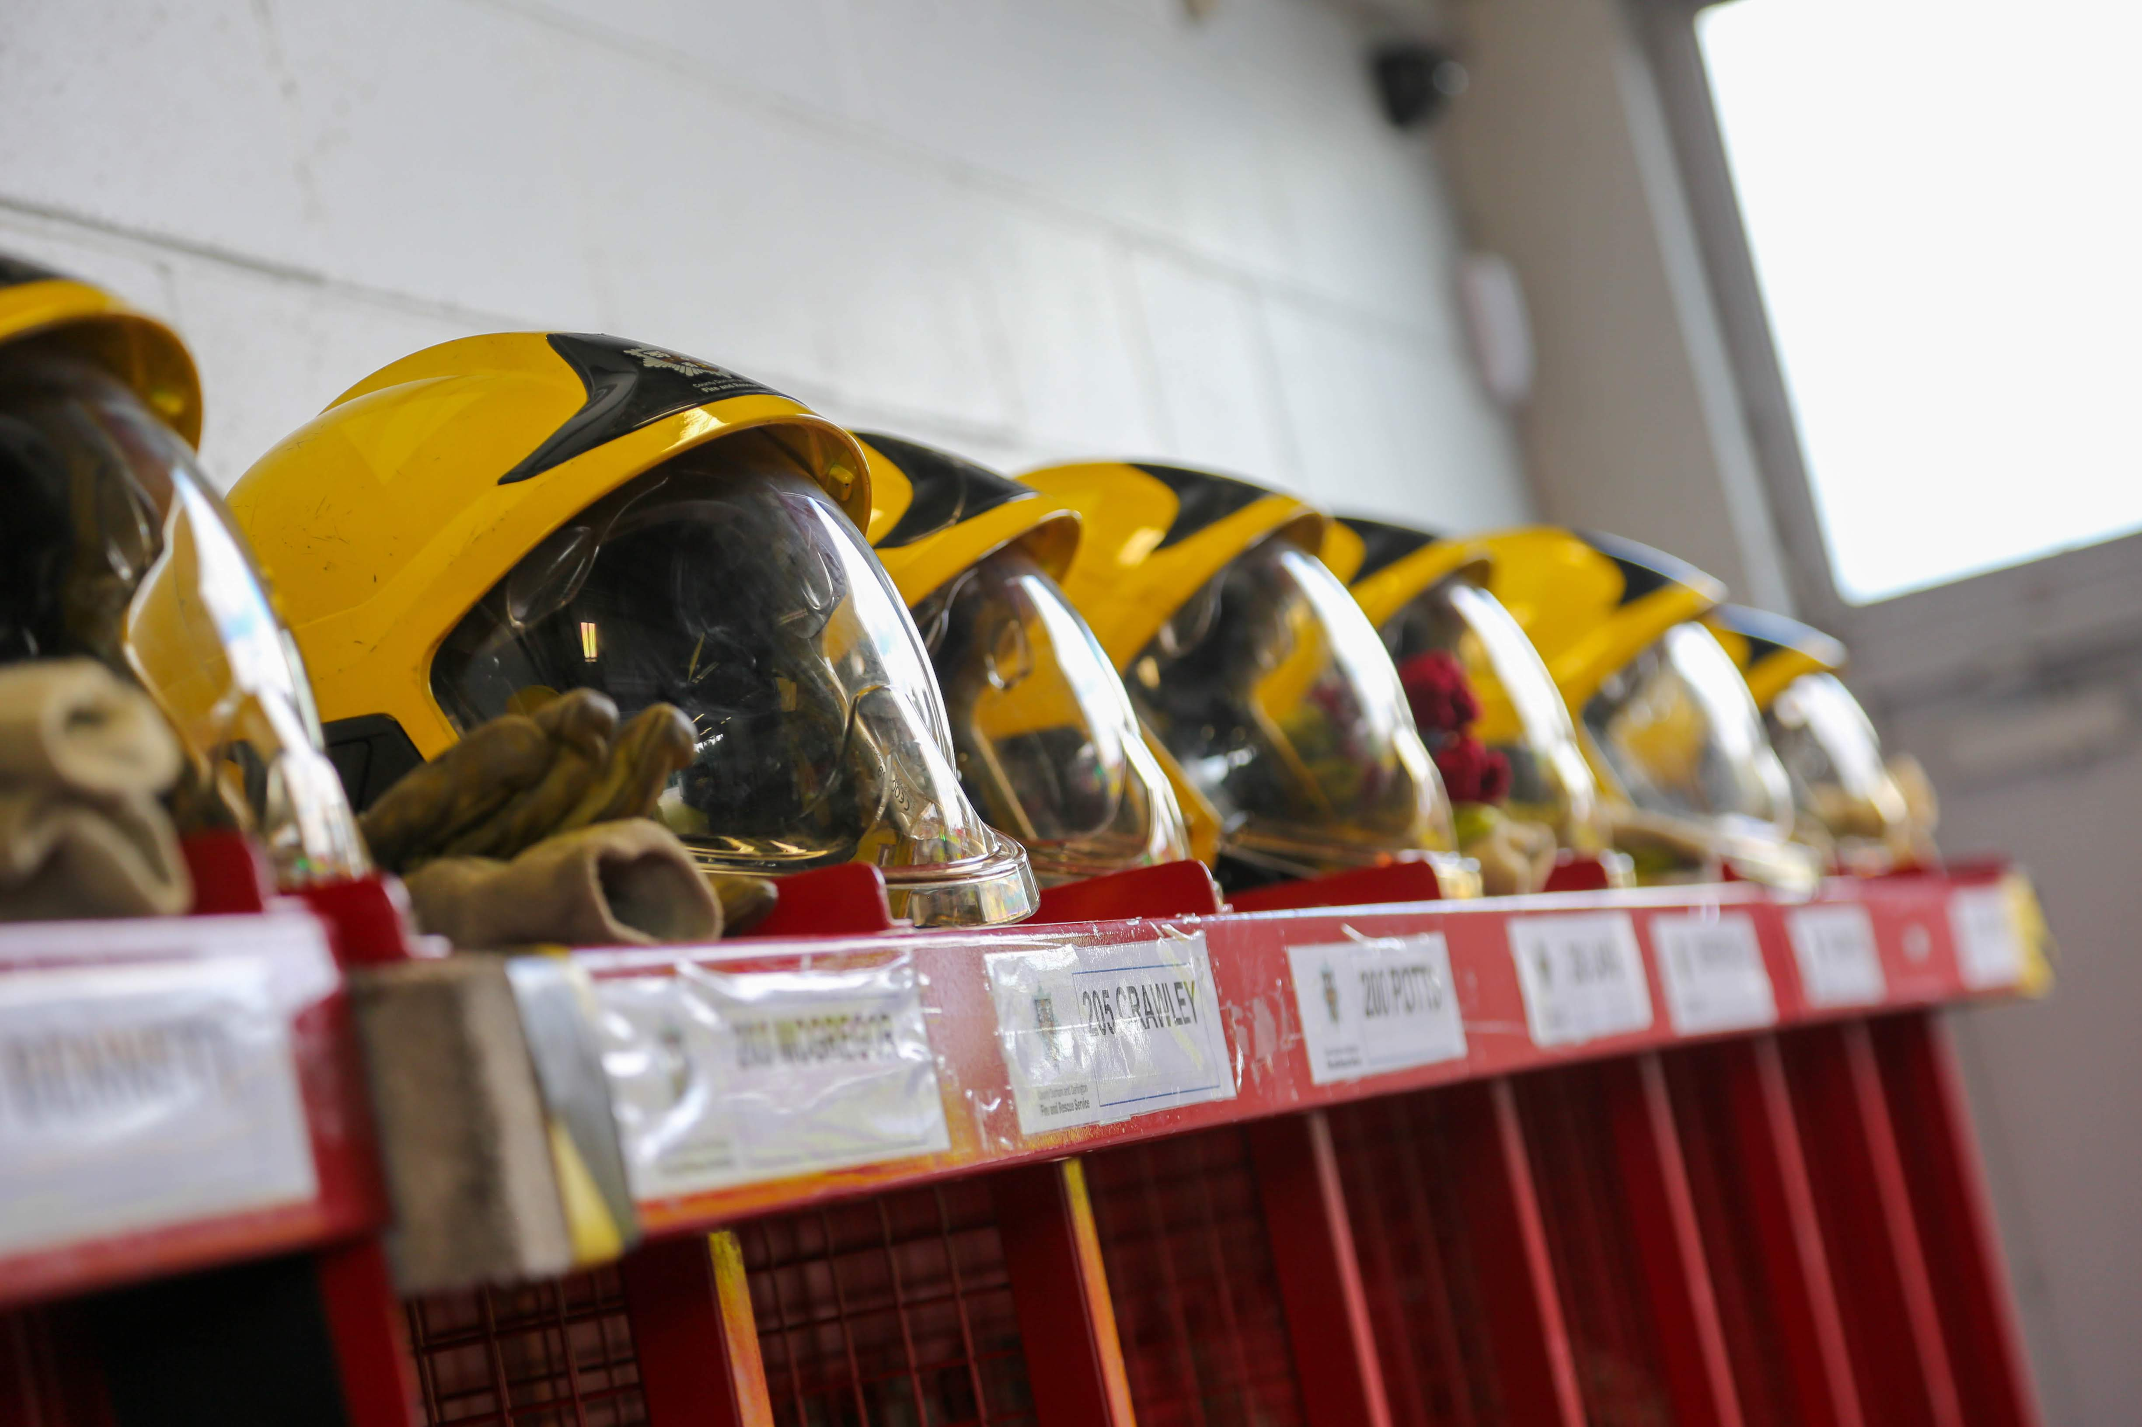
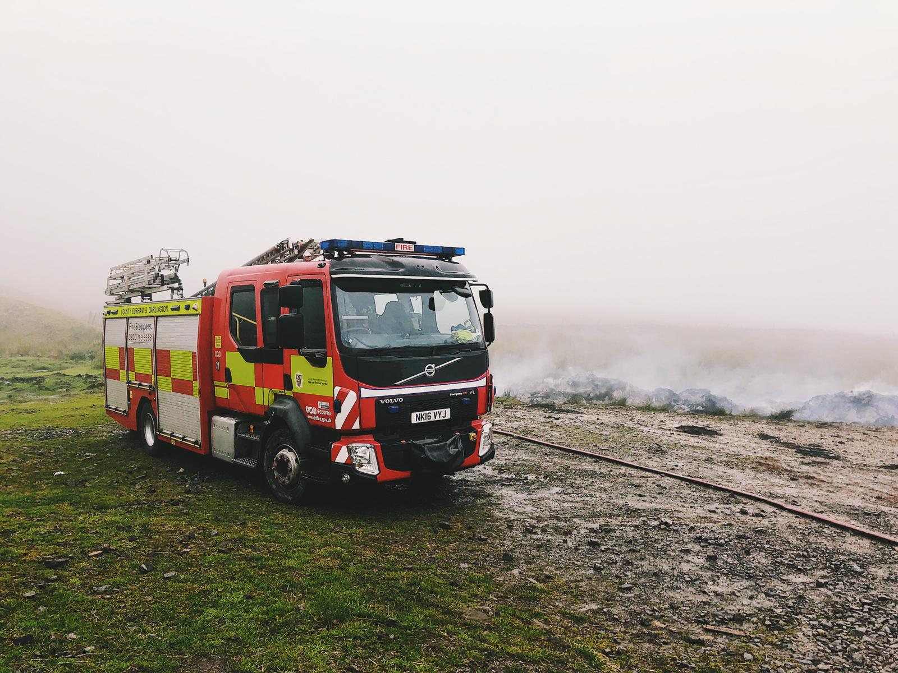
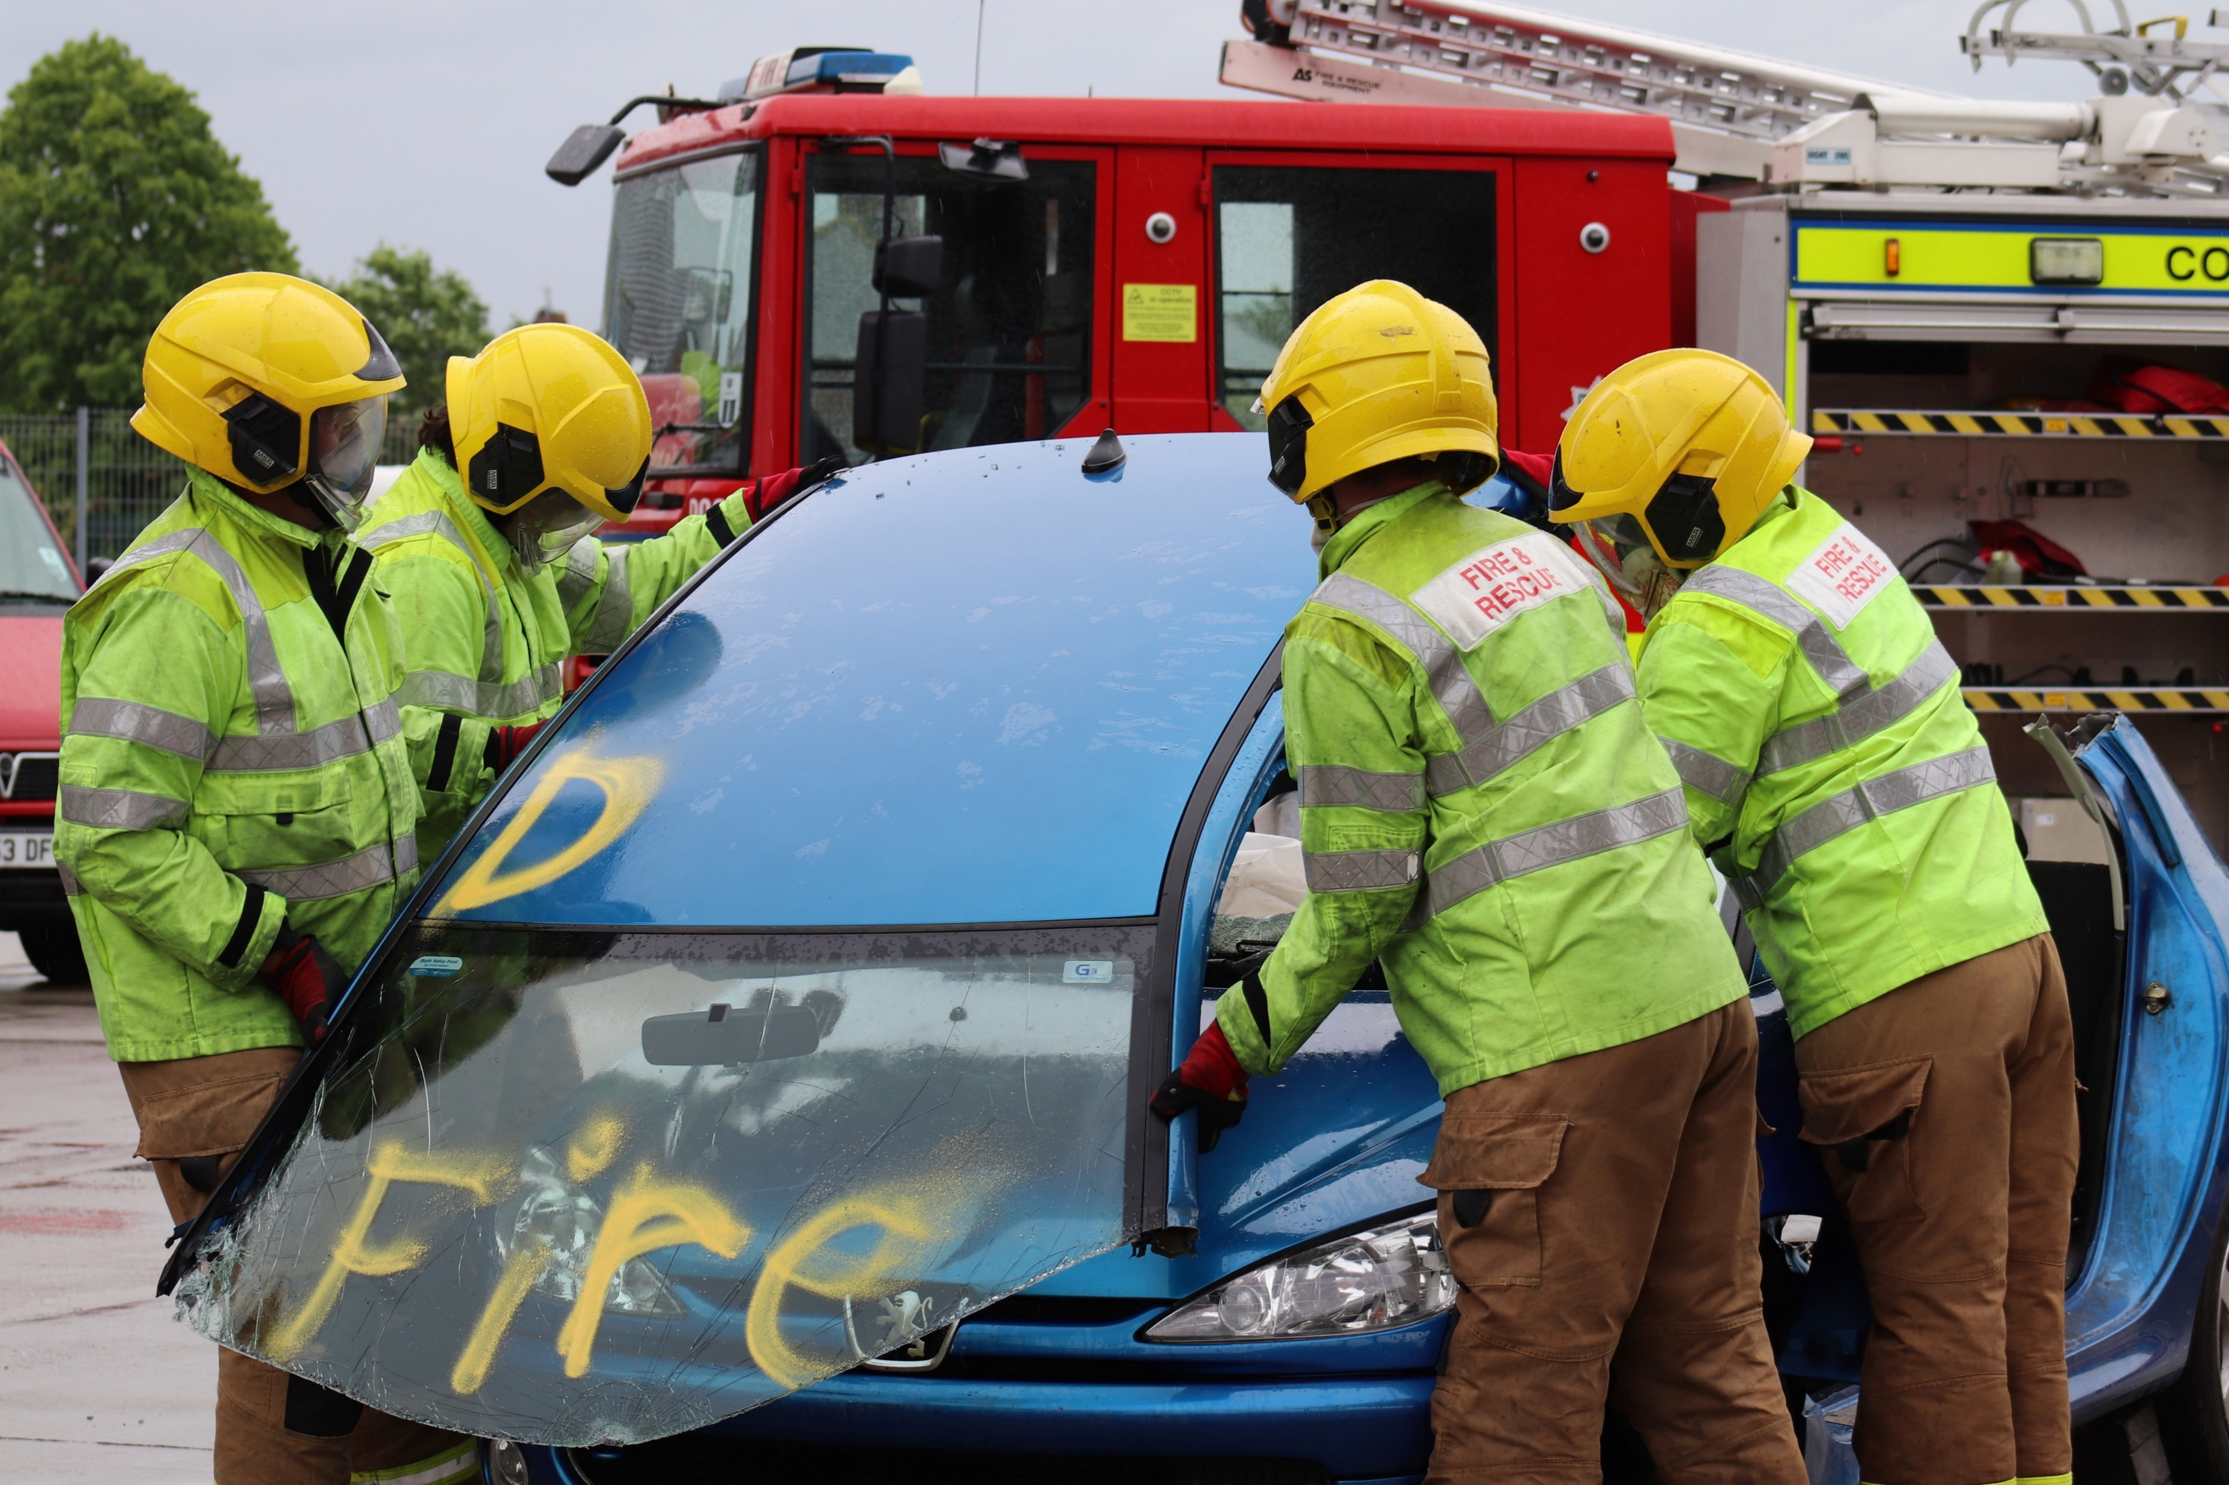
What is a Road Traffic Collision (RTC)?
Summary
Describe the actions on what to do if you come across an Emergency Service vehicle(s) on a blue light response.
Identify who is at risk and the most common factors that lead to RTC’s.
Consequences of Your Actions – Think before you act…
Don’t be another number to add to our statistics
BE ROAD AWARE
Notes:
RTCs will inevitably always happen, but we can reduce them

Slide 11
Any Questions?
Thank you for listening

