Slide 1
Road Traffic Collisions

Slide 2
Introductions -

Slide 3
Aims
      To look at common causes of RTC
      Common injuries caused by RTC
      The after effects of an RTC
      The consequences of RTC

Slide 4
Who does it affect the most?
YOUNG MALE DRIVERS BETWEEN THE AGES OF 17
AND 25.
YOUNG DRIVERS WITHIN ONE YEAR OF PASSING
THEIR DRIVING TEST.
ONE IN THREE NEW DRIVERS WILL CRASH WITHIN
TWO YEARS OF PASSING THEIR TEST.
Notes:
Emphasise the fact that they all point to inexperience

Slide 5
The Facts
NEW DRIVERS TAKE 2 SECONDS LONGER TO RECOGNISE
POSSIBLE DANGER.
THREE YOUNG PEOPLE DIE EVERY DAY IN RTC’s IN BRITAIN.
THE RISK iF HAVING AN ACCIDENT INCREASES WITH EVERY
EXTRA PASSENGER A YOUNG DRIVER HAS IN THE CAR.
66% OF DRIVER DEATHS ARE ON RURAL ROADS
Notes:
Again inexperience
Why higher risk when more passengers – distraction
Why more deaths on rural roads

Slide 6
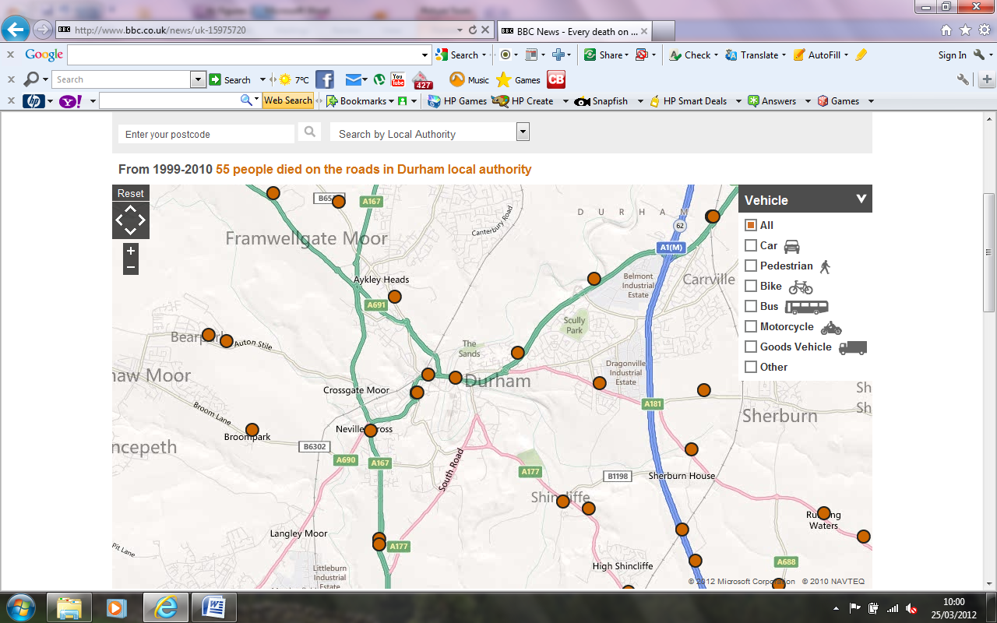
map
Notes:
Taken from BBC website

Slide 7
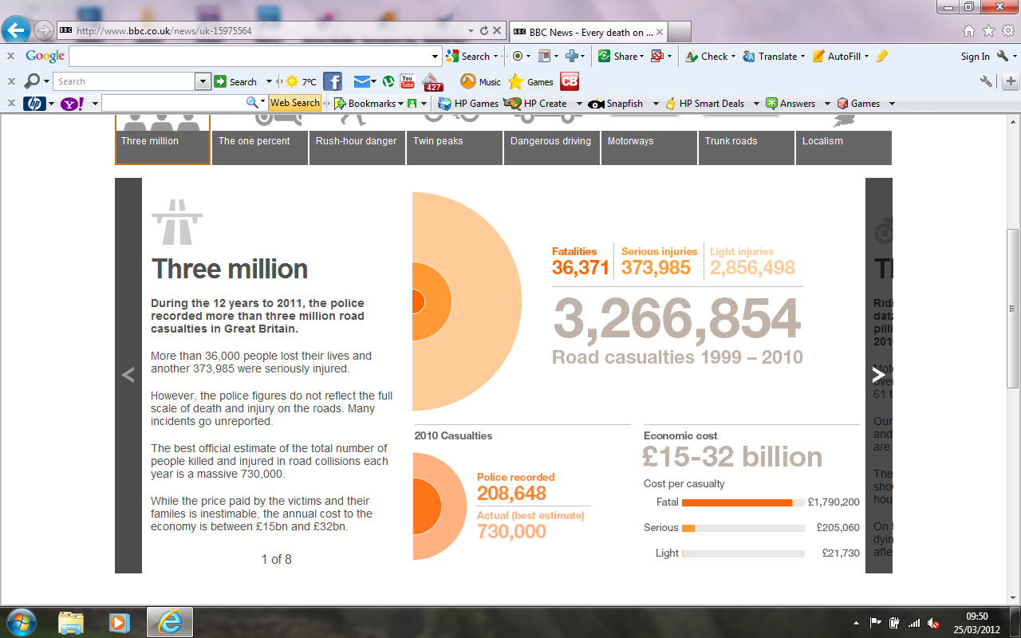
Three million

Slide 8
What do you think are the most common causes of R.T.C’s?

Slide 9
Common causes of RTC
Alcohol
Drugs
Tiredness
Speed
Distraction
Inexperience
Mechanical Defects

Slide 10
The facts
Notes:
Pick someone out of the group and say they are going out on a Friday night and drinking for example Stella which would be the top left. They stop drinking at midnight and ask how long before they would /should be legal to drive again 5 x 3 hour plus one hour absorption would take them to 4pm the next day

Slide 11
The facts

Slide 12
Distraction

Slide 13
Recent survey by the IAM - March 2012
Using smartphones for social networking while driving is more
dangerous than drink driving or being high on cannabis behind the wheel.
8% of drivers admit to using smartphones for email and social networking
while driving – equivalent to 3.5 million licence holders².
24% of 17-24 year old drivers – a group already at higher risk of being in a
crash – admit to using smartphones for email and social networking while
driving³.

Slide 14
Common Injuries
        PHYSICAL
        MENTAL & EMOTIONAL

Slide 15
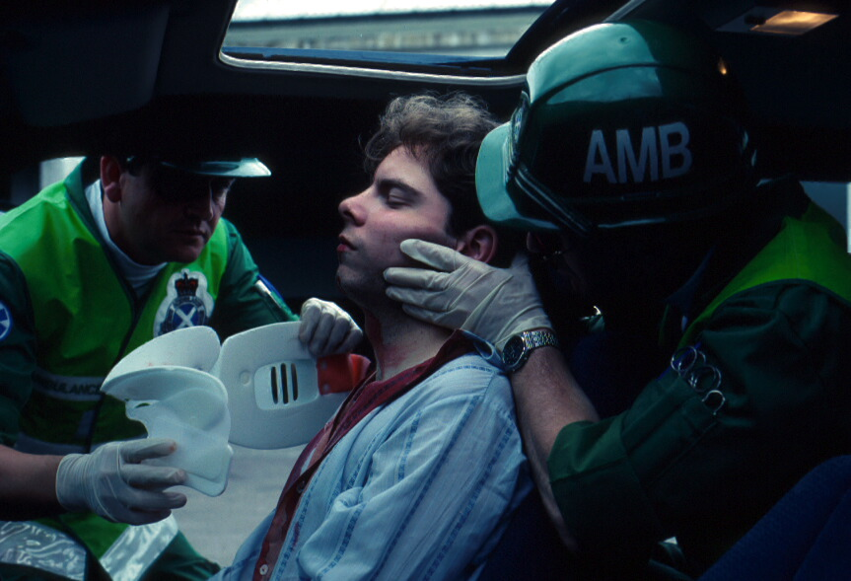
Common Injuries
Physical
        Head & Chest Injuries
        Internal Injuries
        Pelvic and Leg injuries
        Heavy Blood Loss
        Loss of lower limbs
        Shock

Slide 16
Common Injuries -Mental & Emotional
        Anxiety
        Afraid
        Claustrophobic
        Panic
        Cold

Slide 17
AIRBAGS

Slide 18
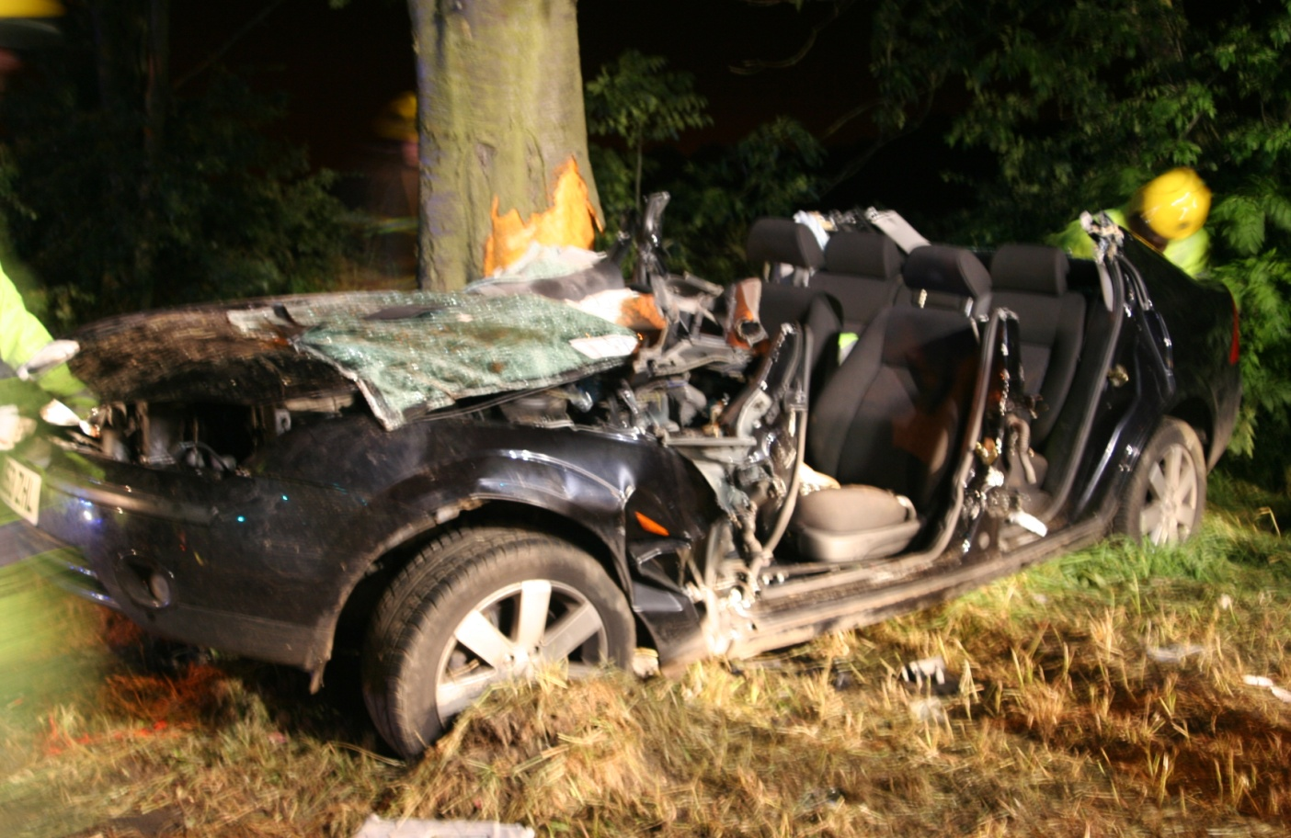
For every vehicle collision
there are three collisions that occur
1. Vehicle Collision

Slide 19
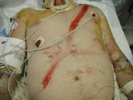
2. Casualty Collision

Slide 20
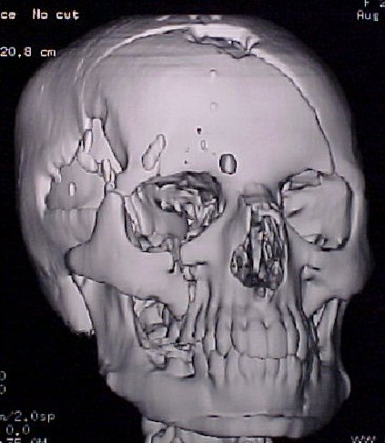
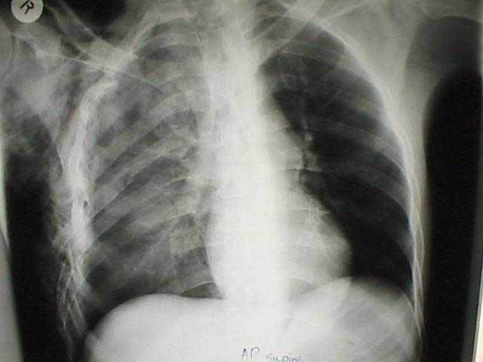
3. Internal Collision

Slide 21
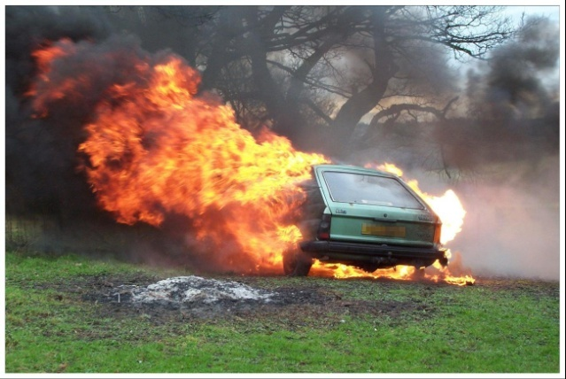
RTC - FIRE
Vehicles on fire
Sudden deceleration may cause:
Fuel lines to fracture
Fuel to leak
short circuit or spark from impact
may cause ignition of vapour

Slide 22
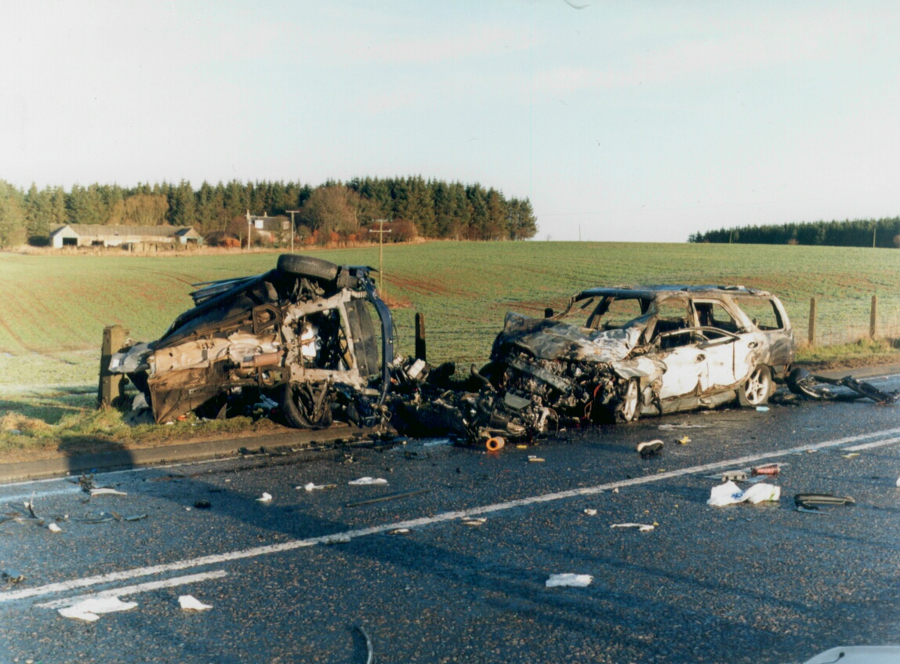
Road traffic collision

Slide 23
Motorcycles

Slide 24
Motorcycles - 5 Points to Safety
Gear up - Wear full protective gear.
Slow up – Stay well within limits, especially on bends.
Wait up – never overtake unless its 100% safe.
Brighten up – Wear light & reflective clothing and use dipped headlights at all times.
Check up – Check and service your bike regularly.

Slide 25
Think !!!!
Seatbelts !
Seatbelts !
Seatbelts !

Slide 26
In a crash of 30mph by how many times does your body weight increase?
X5 X15 X30

Slide 27
In a crash of 30mph by how many times does your body weight increase?
x5 x15 x30

Slide 28
What are the consequences?
Loss of your own Life
Loss of loved ones
Life changing severe disability
The effect on immediate family when they receive the dreaded knock on the door from the Police!

Slide 29
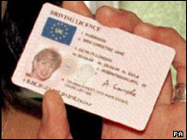
What are the consequences of dangerous driving?
Losing your licence can have a big impact on your daily life
Lots of jobs require a clean driving licence
Money you spend on learning to drive and getting a car will be wasted
Notes:
You don’t just stand to lose cash through unsafe driving, you stand to lose your licence too. In your first two years after passing your test, you only have to accumulate six penalty points to lose your licence (after these first two years, you lose your licence after accumulating 12 points). That means in your first two years of driving, you only have to get flashed three times by a speed camera, for example, to lose your licence.
Losing your licence, or even accumulating a few penalty points can have a major impact on your life. When you leave school or college you may need to drive for your job. Many jobs involve driving as part of the work and therefore require a clean driving licence.
Losing your licence could have a big impact on your leisure time too – for example, you may drive to visit a girlfriend or boyfriend or family, or to attend a sports club.
If you lose your licence may also mean that any money you spent on learning to drive and/or buying a vehicle has been wasted.

Slide 30
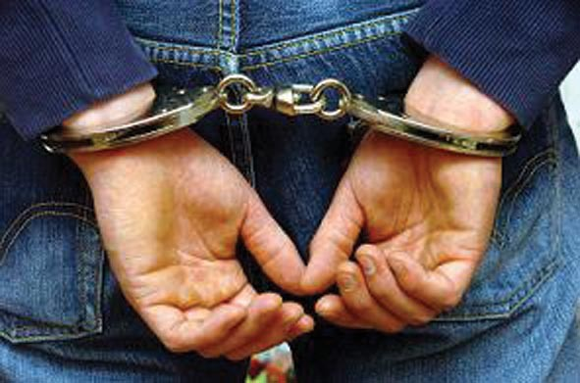
What are the for Maximum Sentences for dangerous driving?
Dangerous driving = 2 years
Serious Injury caused by Dangerous Driving = 5 years
Causing death by dangerous driving = 14 years
Notes:
Every year, 1,885 under 21 year-olds are convicted of ‘causing death by dangerous driving’ and ‘dangerous driving’.
The maximum sentence for ‘dangerous driving’ is two years and the maximum for ‘causing death by dangerous driving’ is 14 years in prison.
Encourage pupils to consider how a lengthy prison sentence would affect their lives. If they went to prison for 2 or 14 years, how old would they be when they got out? How would their friends have moved on by then? How do they think people would regard them when they got out?

Slide 31
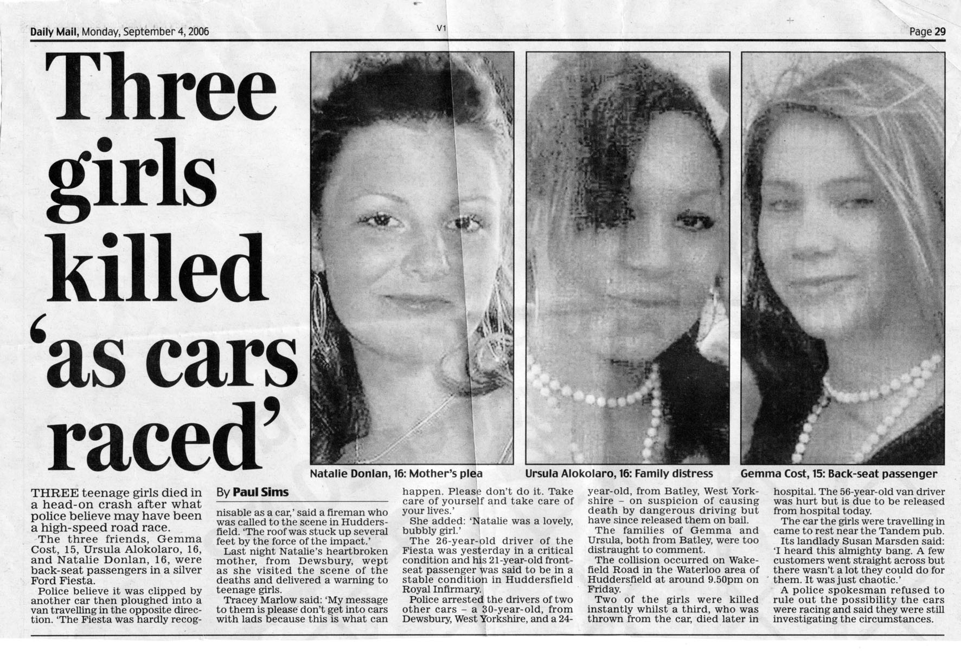
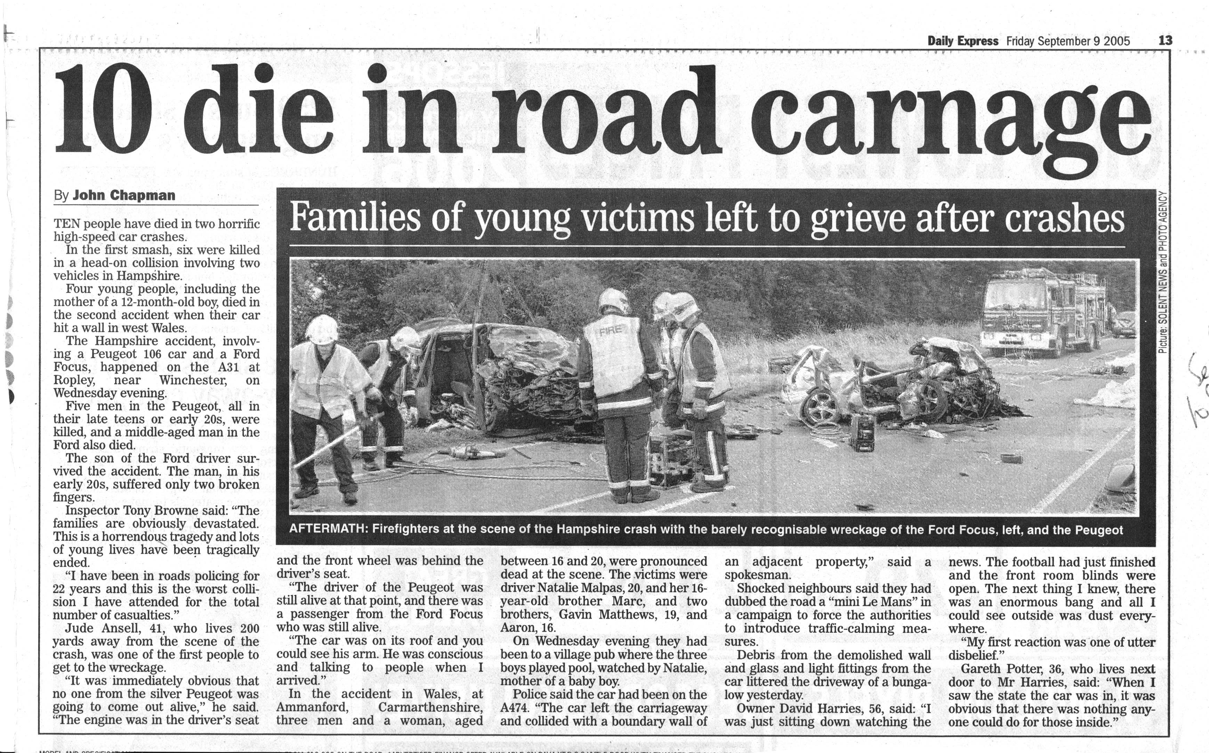
What are THE WORST POSSIBLE consequences of dangerous driving?
Life-changing injury (to you or someone else)
Death (to you or someone else)
Notes:
As well as losing money, your driving licence, and going to prison, the worst possible consequences of driving dangerously is death or serious injury to you or someone else.

Slide 32
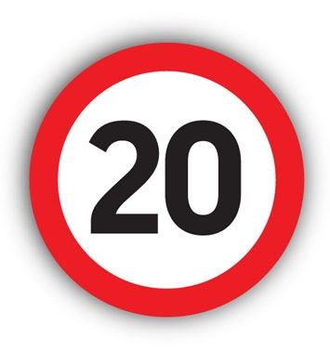
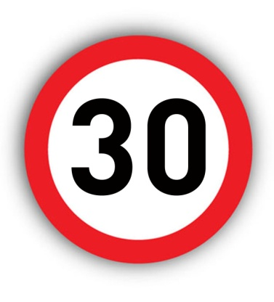
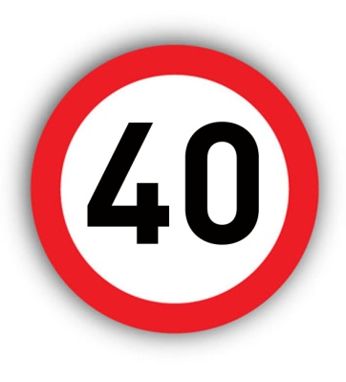
THE FACTS – what are the survival chances of a
pedestrian hit at 20mph, 30mph, 35mph and 40mph?
20mph =
95% chance of survival
30mph = 80% chance of survival
35mph = 50% chance of survival
40mph =
10% chance of survival
If you hit someone on foot or bicycle, your speed
helps determine whether they live or die
The smart choice: slow down to 20mph around schools and homes
Notes:
Going faster doesn’t only mean you have less time to react to hazards, it also means that you’ll hit harder if you do hit something or someone, increasing the chance of causing death and serious injury.
Ask the class to guess what they think a pedestrian’s survival chances are if they’re hit by a car travelling at these different speeds.
[reveal answers]
IF you hit someone at 20mph, they’ll almost definitely live. Hit them at 40mph and they’re almost definitely die.
These figures also show why breaking a 30mph speed limit – even by a little bit – is so dangerous. Hit someone at 35 and they’re more than twice as likely to die as if you hit them at 30mph.
The safe choice is to slow down to 20mph around schools and homes. It’s especially important to drive at this speed if there are pedestrians about who can act unpredictably – like children and drunk people coming out of pubs.

Slide 33

Warning!
Photographs of fatalities involved in R.T.C.

Slide 34
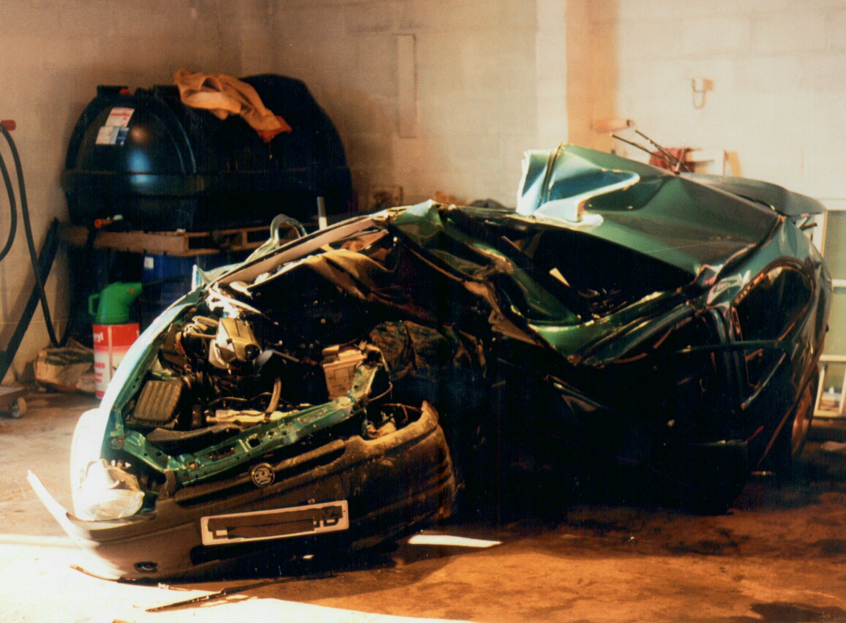
Road traffic collision 1

Slide 35
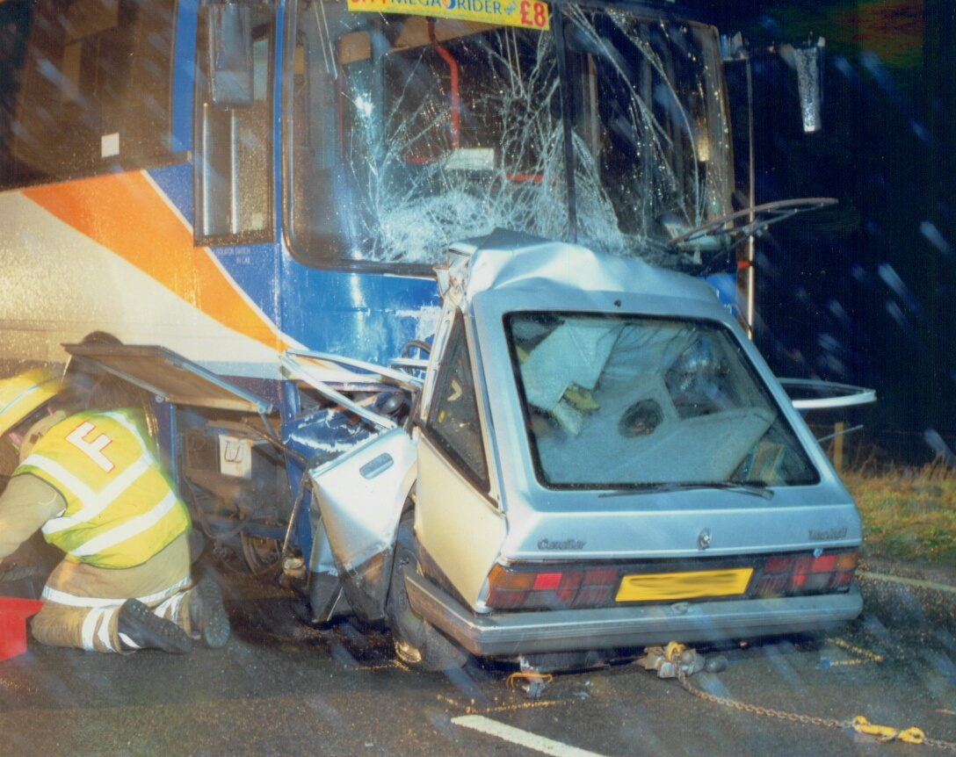
Road traffic collision

Slide 36
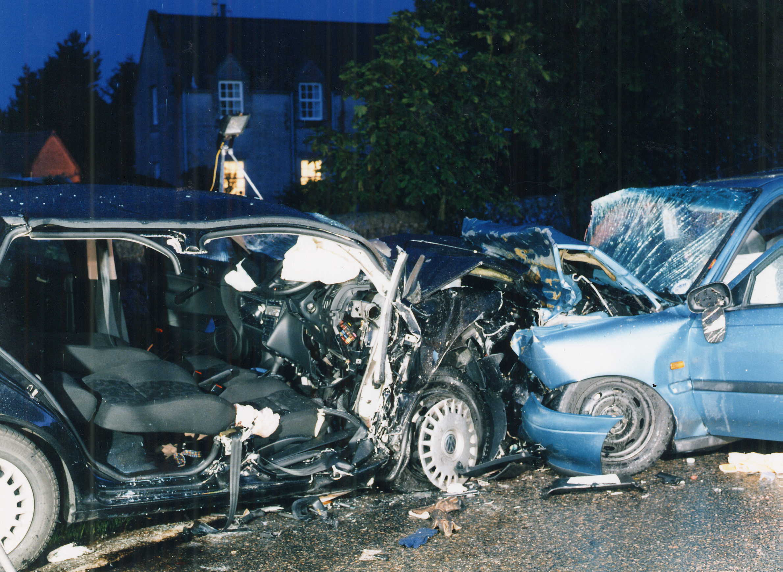
Road traffic collision

Slide 37
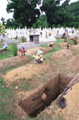
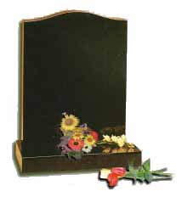
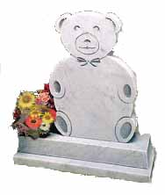
Think about the consequences !!

Slide 38
ANY
QUESTIONS ?
Notes:
Slide 59 - Questions

