Slide 1
Bonfire night video
Notes:
This Presentation is NOT suitable for Primary school pupils.

Slide 2
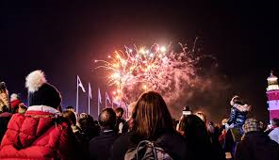
BONFIRE NIGHT & FIREWORK SAFETY FOR SECONDARY SCHOOLS.
Notes:
This Presentation is NOT suitable for Primary school pupils.

Slide 3
Aims of this presentation
The Firework Code
How to have a safer & better Bonfire Night.
To make sure everyone is safe & has an enjoyable Bonfire/Firework period.
Notes:
We will look at the content of the firework code and the safety issues inside this code.
We will discuss why a home fireworks party needs to be safe.

Slide 4
Did you know?
On average, (every year in the UK), 130 fires are started in homes & buildings by fireworks.
The majority of firework related injuries happen at family or private parties.
It is against the law to carry fireworks in public if you are under 18.
Notes:
Encourage children to discuss these points with parents / responsible adults

Slide 5
Did you also know?
It is an offence to throw or set-off fireworks in the street or public place. This could result in prosecution and a fine of up to £5000.
Fireworks must not be sold to anyone under 18.
It is an offence to let fireworks off during the night (between 11pm to 7am) except on Bonfire Night (up to midnight), Diwali, New Year and Chinese New Year.
Notes:
Diwali is the five-day festival of lights, celebrated by millions of Hindus, Sikhs and Jains across the world.

Slide 6
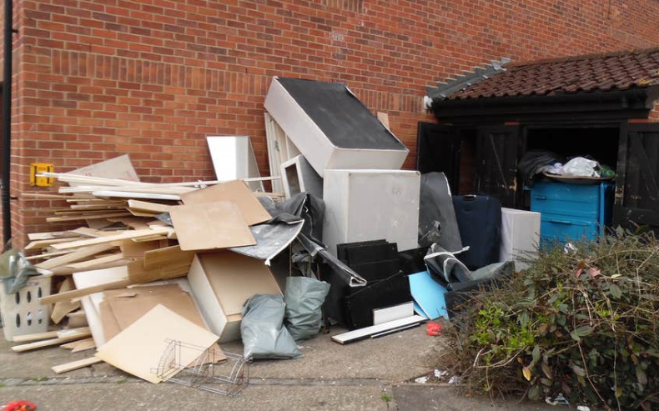
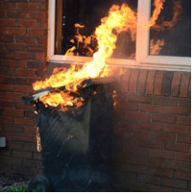
We all should know
It is an offence to take items from a house, property or garden, (even old furniture & pallets etc), that has been left out for waste collection.
Setting fire to a wheelie bin is a crime of theft & criminal damage.
Wheelie bins are not free. If you take one away & destroy it the home owner has to pay £150 to the council for a new one.
Notes:
Classroom discussion:
Why is it an offence to take waste from someone’s home?
Trespass and the offence of theft (waste is still someone’s property until the Council remove it)
Criminal Damage, (Arson), is the starting of a fire, even on your own property, that may cause damage to other properties. Why could someone be arrested for a fire that spreads from the original bonefire.

Slide 7
Know the Fireworks Code
Only an adult can buy fireworks in the UK.
Legal fireworks must be to BS7114 safety standard.
Only an adult should handle & light fireworks.
Alcohol & fireworks don’t mix. The adult lighting the fireworks should avoid alcohol until the home display has finished
Keep fireworks in a closed box to avoid sparks.
Read & follow the instructions carefully on each firework.
Light them at arms length, using a taper.
Stay back at least 8m.
Light them at arms length, using a taper.
Never go back to a lit firework, even if it hasn’t gone off, it could still explode.
Never throw or put fireworks in your pocket.
Notes:
Class discussion:
What could go wrong with a home bonfire party?
The risk of accidents, and what these may be?
What are the risk alcohol presents to the fireworks display?
Why can only Adults purchase fireworks?

Slide 8
Even Sparklers can be dangerous
Light sparklers one at a time & always wear gloves.
Supervise smaller children & never give sparklers to a child under five.
Have bucket of cold water nearby to drop the spent sparkler rods into.
Never throw sparklers.

Slide 9
Due to Covid-19, organised firework displays will not be held this year. Please do not build bonfires as these damage property, the environment and draw Fire Engines away from where they are needed.
Social distancing rules allows you to mix only with members of your household or support bubble. The Fire Service is strongly advising communities not to have events at home.
Notes:
Class discussion:
Why do bonfires cause damage to people’s property?
The bonfire is too large and the fire spreads to fences and sheds etc.
The bonfire is built from materials that are dangerous.
What environmental damage could bonfires cause?
Polyurethane foam in furniture creates dense smoke that contain Carbon Monoxide, Hydrogen Cyanide.
The waste from the fire contains a range of other dangerous chemicals that will contaminate the land and water ways.
Animals and wildlife take refuge inside bonfires when they are being built. Many animals such as Hedgehogs die in bonfires.

Slide 10
Any Questions?

