Slide 1
BONFIRE NIGHT & FIREWORK SAFETY
What should we remember?
Notes:
This Presentation is suitable for Primary school pupils.

Slide 2
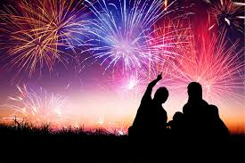
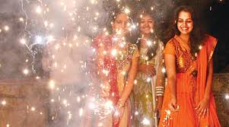
Fireworks
Fireworks are loud, spectacular, beautiful and exciting!
In the UK we have the annual Bonfire Night fireworks and other celebrations through the year.
Can you tell me other times in the year fireworks are used?
Fireworks can also be very dangerous if we forget to follow the Fireworks Code.
Notes:
What sort of celebrations do people like to use fireworks for?
What are the best things about fireworks and fireworks night?

Slide 3
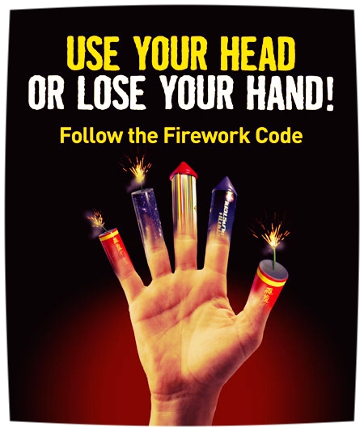
The Firework Code
Adults should only buy fireworks over the counter from respected stores.
Only an adult should handle and light fireworks.
Fireworks should be kept in a closed box away from sparks.
An adult should read and follow the instructions for lighting fireworks carefully.
Fireworks are lit at arm's length.
Always stand well back (8m is best) .
Never go back to a lit firework.
Never put fireworks in your pocket.
Never throw fireworks.
Notes:
Always follow the fireworks code.
Ask the pupils what are the dangers of fireworks?

Slide 4
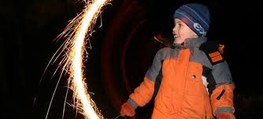
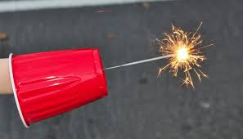
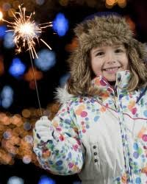
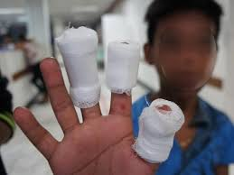
Sparklers
Never touch burning sparklers and always put used sparklers into a bucket of water.
Always wear gloves when holding sparklers.
You could make a
‘cup-glove’
to be really safe.
Notes:
Never give sparklers to a child under 5 years old.
Always wear gloves
Keep the sparkler away from your face, (hold them at arms length)
Never try to hold a sparkler once it has gone out
You could make a ‘Cup – Glove’ by inserting the sparkler through the base of a plastic cup and hold the wire inside the cup to prevent the sparkler burning your hands.

Slide 5
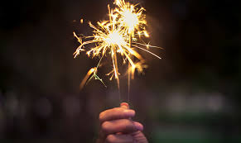
The Firework Code & Sparklers
Remember to light only one sparkler at a time.
Notes:
Only light one sparkler at a time.
Hold at arms length
Wear Gloves
Put the used sparkler in a bucket of water when it burns out.

Slide 6
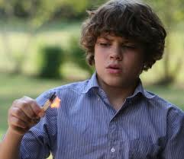
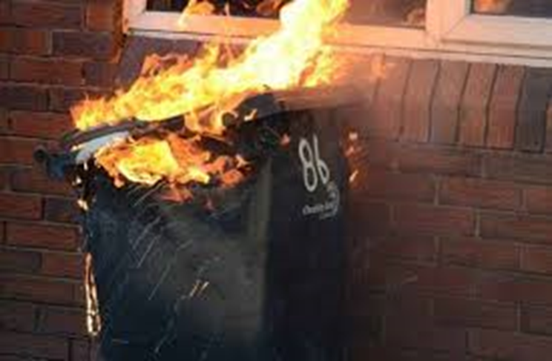
Deliberately starting fires
Bonfires are dangerous and cause a lot of damage.
Starting fires isn’t clever or smart…
its dangerous.
It places other people at great risk.
It places the person starting the fire at the GREATEST RISK of harm!
Notes:
Only Organised fireworks displays can legally have a bonfire. If you build a bonfire yourself, you are not only breaking the law, you are at risk of setting fire to other things like a fence, hedge, car or a house. The bonfire could collapse and burn you or worse.

Slide 7
Bonfires
Wheelie bins are NOT free. If you steal a wheelie bin for a bonfire, you will have committed a crime!.
Items left in the street for collection are not yours to take away. These items are NOT to make into a bonfire.
Notes:
Talk the pupils through the following points:-
People put lots of different materials out in the street to be collected by the Councils. Just because its in the street does not mean that someone can set alight to it. The fire may cause damage to nearby houses or cars.
Wheelie bins belong to someone, even when they are left standing in the street or the back alleyways of streets. If someone sets fire to a wheelie bin, the bin must be replaced and the owner of that bin, (potentially your parents), will have to pay for the replacement bin.

Slide 8
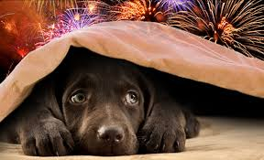
Pets on Bonfire Night
Fireworks and loud noises on bonfire night can scare pets.
Please make sure that pets are kept indoors.
Notes:
Make a comfy space for your pet under the stairs or under the kitchen table with blankets and a chew toy or bone. Leave the radio on to distract your dog from the noise of fireworks. If you are going to an organised display, when you get home make a big fuss of your dog and give it a treat to make sure that it knows it is safe at home.

Slide 9
So, lets check some facts with Ben
Notes:
Ask the pupils to go through each of the points again to make sure they have understood the key points of the Fireworks Code.

Slide 10
Any Questions?

